Slide 2

NETFLIX STOCK MARKET
ANALYSIS
PRESENTED BY: SHUBHAM UPADHYAY
PROJECT FILE: NETFLIX STOCK DATA ANALYSIS

Slide 3

OBJECTIVE
"Analyze Netflix's stock [performance/ trends/ potential] to [inform investment decisions/ evaluate growth potential/ assess relative value] and provide recommendations for [investment strategies/ portfolio management]."

Slide 4
OBJECTIVE
VOLUME OF STOCK TRADED
1
NETFLIX STOCK PRICE - HIGH, OPEN AND CLOSE
2
NETFLIX STOCK PRICE - DAY, MONTH AND YEAR WISE
3
TOP-5 DATES WITH HIGHEST STOCK PRICE
4
TOP-5 DATES WITH LOWEST STOCK PRICE
5

Slide 5
VOLUME OF STOCK TRADED
The graph shows the volume of Netflix stock traded over time. The x-axis represents dates, and the y-axis represents the volume of shares traded on that day. Here are some key observations:
Overall Trend: The volume of Netflix stock traded has been increasing over time, with some periods of higher and lower activity.
High Volume Periods: There are several spikes in the graph, indicating periods of high trading activity. These spikes often coincide with news events or announcements related to Netflix.
Lower Volume Periods: The periods between the spikes show lower trading volumes, suggesting a more stable period for the stock.

Slide 6
NETFLIX STOCK PRICE - HIGH, OPEN AND CLOSE

Slide 7
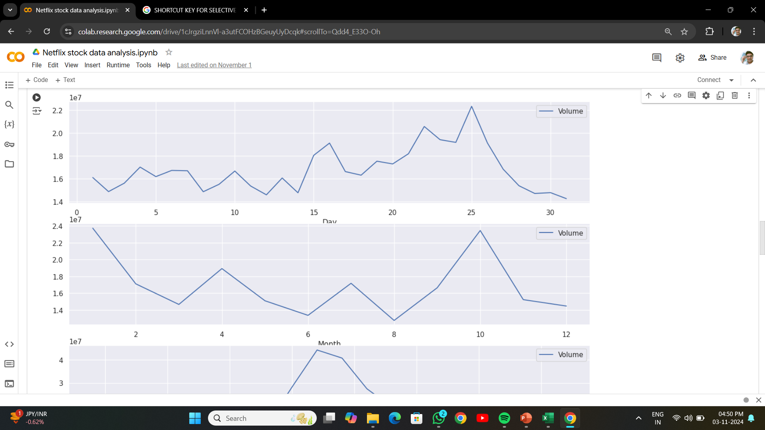
NETFLIX STOCK PRICE - DAY
HERE YOU SEE THE TREND LINE OF STOCK PRICE BASED ON DAYS

Slide 8
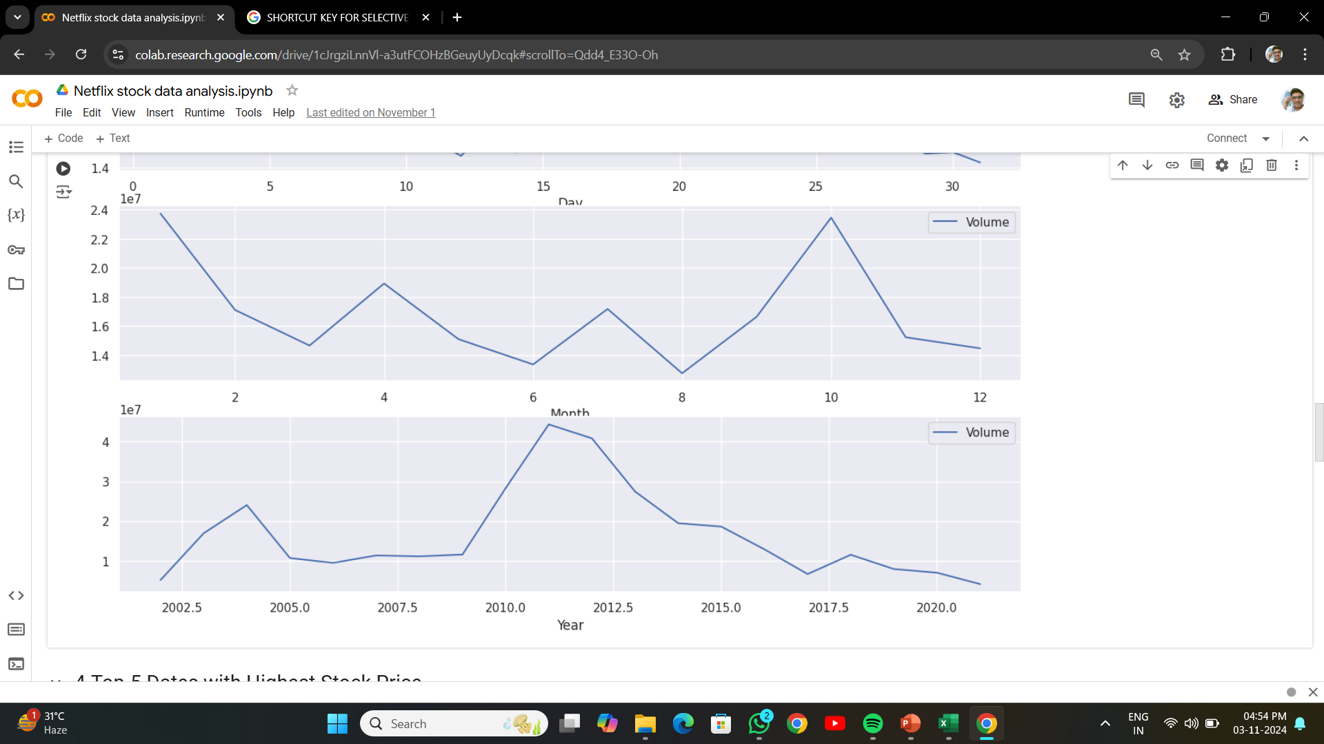
NETFLIX STOCK PRICE - MONTH
HERE YOU SEE THE TREND LINE OF STOCK PRICE BASED ON MONTHS

Slide 9
NETFLIX STOCK PRICE - YEAR
HERE YOU SEE THE TREND LINE OF STOCK PRICE BASED ON YEARS

Slide 10
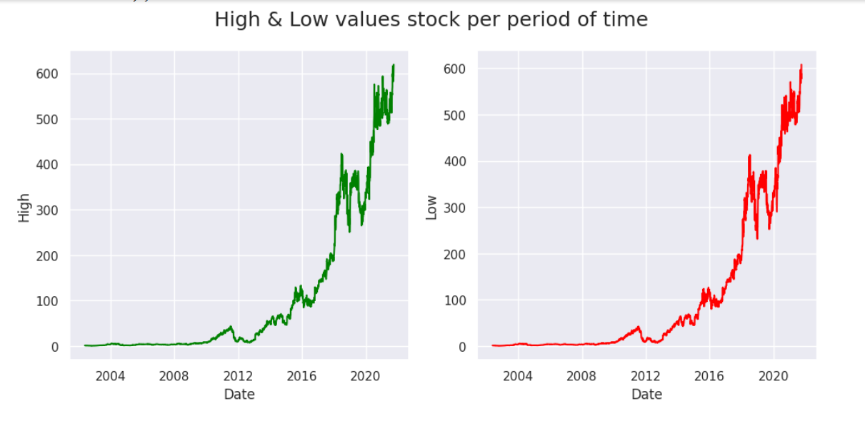
TOP-5 DATES WITH HIGHEST & LOWEST STOCK PRICE
HERE YOU SEE THE TREND LINE OF HIGHEST & LOWEST STOCK PRICE

Slide 11

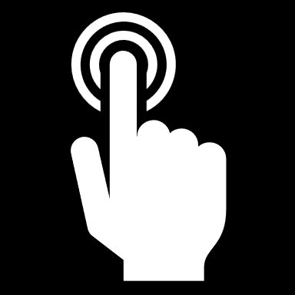
CONCLUSION
Here is a concise analysis of Netflix's stock market performance from beginning to end. Please note that this data is rough and may contain errors

Slide 12
THANK YOU

